Slide 1
Case 4: Drug-eluting Stent / lung mass surgery (12 of 18 properties:#1,4-10,13,15,16,18)
Patient case: Mr. Grant is a 73 year old male, height 183 cm, weight 80 kg, BMI: 23.9.
Current problems: MI and 2 months post Drug-eluting Stent surgery
Current medications: Aspirin, Clopidogrel – dual antiplatelet therapy after the stent operation.
New problem: Lung mass
Management scenario: Patient had MI and the doctors decided to implant a drug-eluting stent. Accordingly, the patient was placed on dual anti-platelet therapy: aspirin + clopidogrel for 12 months.
Two months after the stent implantation, the patient was diagnosed with a lung mass and surgery is indicated and cannot be postponed till dual antiplatelet therapy is completed.

Slide 2
Guidelines
2017 ESC focused update on dual antiplatelet therapy in coronary artery disease developed in collaboration with EACTS. European Heart Journal (2018) 39, 213–254; doi:10.1093/eurheartj/ehx419 LINK
Perioperative Antiplatelet Therapy (2010). P G Chassot, C Marcucci, A delabays, D R Spahn, SPAHN. Am Fam Physician. 2010 Dec 15;82(12):1484-1489. LINK
Urgent surgery in patients with a recently implanted coronary drug-eluting stent: a phase II study of ‘bridging’ antiplatelet therapy with tirofiban during temporary withdrawal of clopidogrel. S. Savonitto, M. D’Urbano, M. Caracciolo, F. Barlocco, G. Mariani, M. Nichelatti, S. Klugmann and S. De Servi. British Journal of Anaesthesia 104 (3): 285–91 (2010). doi:10.1093/bja/aep373. LINK

Slide 3
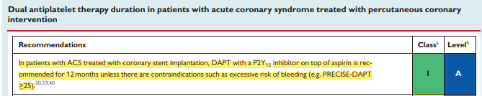
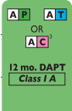
Dual antiplatelet in CAD guideline
[1] p. 233
Three P2Y₁₂ inhibitors are indicated: Ticagrelor, Prasugrel, or Clopidogrel
[1] p. 229

Slide 4
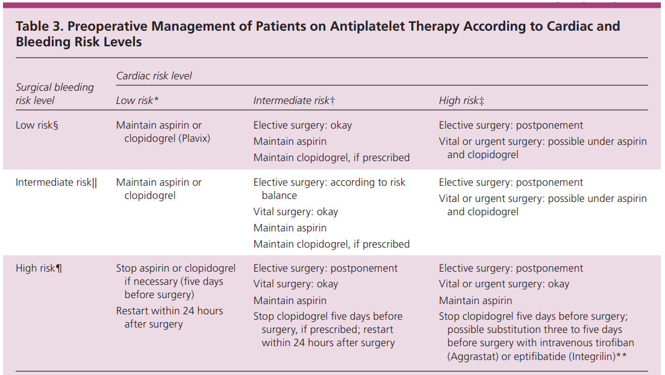

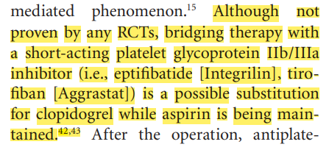
Perioperative antiplatelet guideline + Ref #3
[2] p. 1487
[2] p. 1484
This reduces the risk of bleeding during surgery, due to decreased platelet aggregation.
[2] p. 1488
[3] p. 285 (Bridging therapy details)

Slide 5
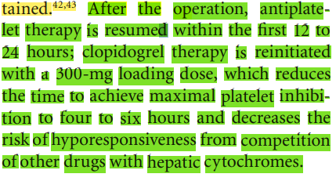
More from Perioperative antiplatelet guideline
[2] p. 1488

Slide 6
Domain knowledge
Knowledge | Sources
Clopidogrel is a platelet aggregation inhibitor | ATC (Anatomical Therapeutic Chemical) classification. World Health Organization. LINK
In the CVD guideline, clopidogrel is given to reduce the risk of thrombosis | [1] p. 219: “Current evidence suggests that DAPT mitigates the risk of stent Thrombosis”
Platelet aggregation inhibitors increase risk of bleedings
The antiplatelet effect of clopidogrel lasts for 5 days | [L1] p. 13: “Platelet aggregation and bleeding time gradually return to baseline values after treatment is discontinued, generally in about 5 days.” LINK [L2] p. 746: “Residual anti-aggregating activity was noted 5 days after the end of 14 days’ treatment.” LINK
Surgery increases the risk of bleedings
Tirofiban, Ticagrelor and Prasugrel are platelet aggregation inhibitors | ATC (Anatomical Therapeutic Chemical) classification. World Health Organization. LINK
The antiplatelet effect of tirofiban lasts for 4-8 hours | “In ~90% of patients, ex vivo platelet aggregation returns to near baseline in 4 to 8 hours after discontinuation.” LINK
Notes:
This slide shows the first-principle pieces of medical knowledge that can be used to support decisions for the given use case, paired with their sources. In particular, from the ATC classification, we know that clopidogrel is a platelet aggregation inhibitor (first row), such as Tirofiban, Ticagrelor and Prasugrel (sixth row). This kind of knowledge can be obtained exploiting repositories such as ATC (maintained by the WHO), SNOMED CT or DRUGBANK.
Platelet aggregation inhibitors may increase the risk of bleedings (third row). I have not specified a knowledge source for this information (such as for the fact that also surgery increases the risk of bleedings), because they represent basic medical knowledge.
From the CAD guideline, we also know that the dual antiplatelet therapy (see row 2) is given to prevent thrombosis (i.e., to reduce cardiovascular risk). Often, this kind of information is contained in the guidelines (but it often corresponds to the indications of the drug in DRUGBANK).
Finally, one can also exploit knowledge about the duration of the effects. Usually, such a kind of knowledge can be derived from pharmacodynamics and pharmacokinetics studies. For instance, for our case study, it can be useful to take into account that the effect of clopidogrel lasts about five days (row 4), while the effect of tirofiban is 4-8 hours (see row 7).

Slide 7
Mitigation of Adverse Interactions
Adverse interactions
Conflicting goals/actions: decrease platelet aggregation to reduce risk of thrombosis after stent implanted: Aspirin+Clopidogrel
vs.
elevate platelet aggregation to normal, to reduce risk of bleeding during surgery: Suspend Clopidogrel
While Clopidogrel is suspended patient is at risk of thrombosis
Bridging therapy to decrease risk of thrombosis to minimum by starting a less effective antiplatelet that is cleared out of the body more quickly than clopidogrel
Suggested treatment
Suspend clopidogrel 5 days before
Bridging therapy: start tirofiban 24 h later; suspend it 4 h before surgery; resume it 2 h after surgery until oral clopidogrel is resumed
After the operation, resume Clopidogrel within the first 12 to 24 hours; clopidogrel therapy is reinitiated with a 300-mg loading dose
Relevant aspects
Level of evidence for treatment (e.g., no bridging vs. bridging, based on paper [3])
Clinician preference and experience
Level of risk

Slide 8
Features for decision support
 | - type of interaction
A1 | Drug from a CPG has an effect on a comorbid condition (including ADE) | clopidogrel affects high bleeding risk
A3 | Clinical goals from different CPGs may conflict | Decreased platelet aggregation to prevent thrombosis after stent vs. Prevent bleeding during long surgery
A5 | Duplicate or redundant advice from different CPGs | Dual antiplatelets (aspirin + Clopidogrel/Tirofiban)
A6 | Temporal relationship between different CPGs | [2] “After cessation of aspirin or clopidogrel, platelet aggregation returns to baseline in five days”. This reduces the risk of bleeding during surgery, due to decreased platelet aggregation. [2] “The high dose reduces the time to achieve maximal platelet inhibition to four to six hours and decreases the risk of hyporesponsiveness from competition of other drugs with hepatic cytochromes”.
A7 | Multiple interactions from different CPGs occurring at the same time | MI; Stent implantation; Lung mass surgery
 | - types of mitigation
B2 | Adjust drug dosage | Adjust drug dosage for safer treatment (75→300mg clopidogrel)
B4 | Replacing a drug with a safer / non-interacting drug / more effective drug for comorbidity | Replace clopidogrel with safer drug (tirofiban)
B4 | Replacing a drug with a safer / non-interacting drug / more effective drug for comorbidity | Replace Clopidogrel with more effective drug (tirofiban: less potent but clears more quickly);
B5 | Discard unsafe/interacting drug | Suspend Clopidogrel
B6 | Delay a task to avoid a temporal overlap | Delay clopidogrel not to overlap with surgery
B7 | Add a task to ensure a temporal overlap | Add tirofiban to ensure overlap with surgery effect and aspirin
 | - Other features
C1 | Patient preferences and/or patient burden | Reduce risk of bleeding during surgery by suspending Clopidogrel Reduce risk of thrombosis by switching clopidogrel with tirofiban while giving aspirin the entire time
C4 | Alternative mitigation strategies for a single interaction | [2] p. 1487 tirofiban or eptifibatide (as bridging therapy)

